Slide 1
What is a website that will give me appropriate and reliable information? REAL test for Websites (Alan November)
Read the URL
Examine the site’s content and history
Ask about the publisher or the author
Look at the links

Slide 2
Read the URL

Slide 3
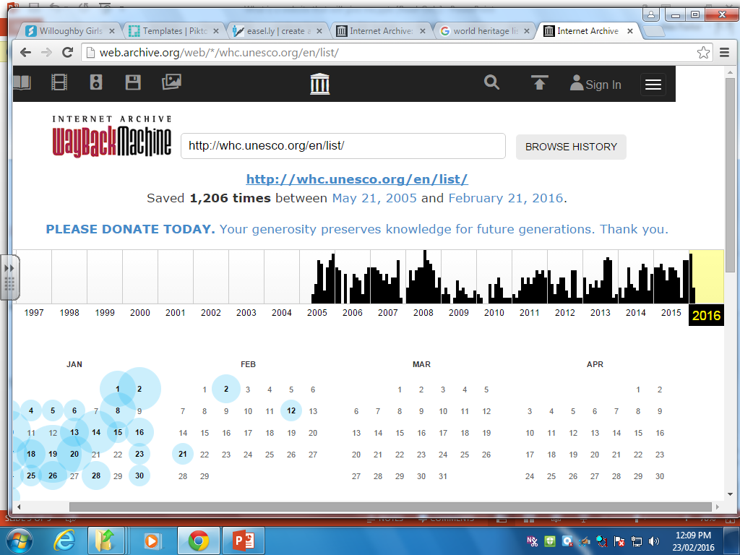
Examine the website’s content and history
Check the following:
The date at the bottom of the page.
Date of copyright or when last published.
Webtool - Archive Wayback Machine https://web.archive.org/

Slide 4
Ask about the publisher or author
Google the author or publisher
Webtool: Domain lookup service
easywhois (http://www.easywhois.com)
Eg. Search Martin Luther King
One search result is martinlutherking.org
martinlutherking.org is a website hosted by stormfront.org
Research stormfront and discover it is white supremacist organisation with a certain bias

Slide 5
Look at the links
Search using a number of search engines google, bing…
Look beyond the “top hits”
Type link: into the search bar followed directly by the URL to gain a list of webpages that link to the website.

